Slide 1




18ECP103L-MINOR PROJECT II
DETECTION OF MINERAL AND MINERAL MATERIALS
USING ESP32CAM WITH AI&ML
PRESENTED BY:
N.RESHMA (927622BEC165)
K.S.PRABHAVATHI (927622BEC145)
P.PRIYADHARSHINI (927622BEC156)
M.SAMUTHRA (927622BEC170)
Guided by:
Dr.S.MEIVEL

Slide 2
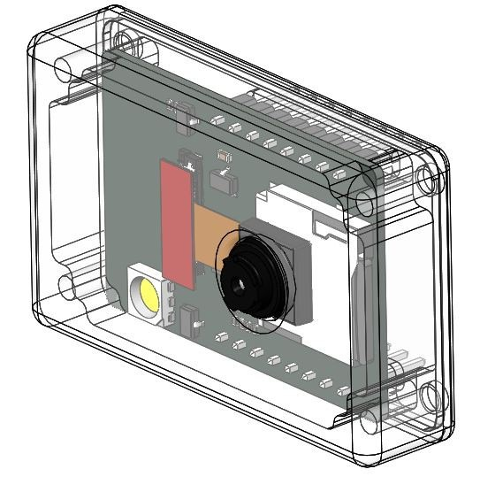

Prototype of the innovation

Slide 3
INTRODUCTION
Welcome to the our presentation on detection of mining and Mineral materials using esp32cam .In this session, we will explore how the esp32cam can revolutionize mining operations .we will discuss its benefits, application, and key features that make it an efficient tool for mineral detection.
OBJECTIVE
Soil mineral prediction system using esp32cam with AI&ML to check whether the soil is suitable for construction or agriculture site.

Slide 4
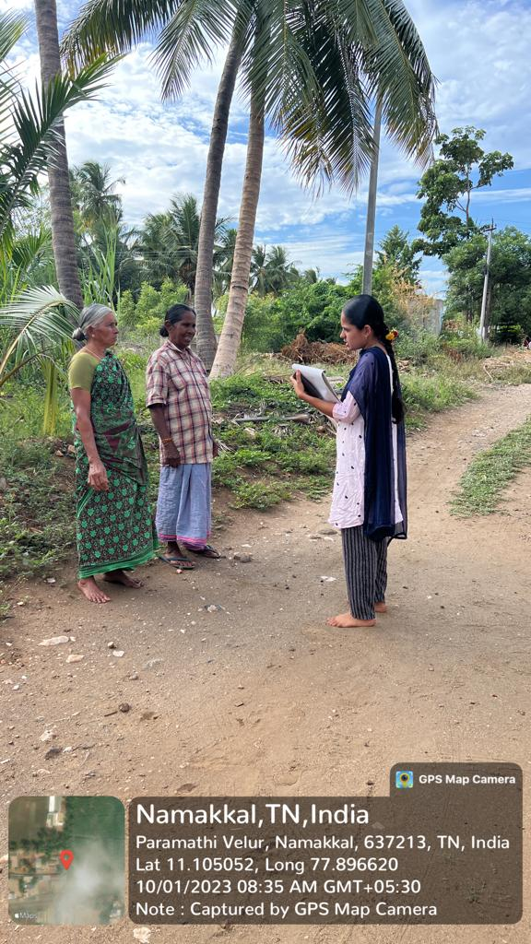
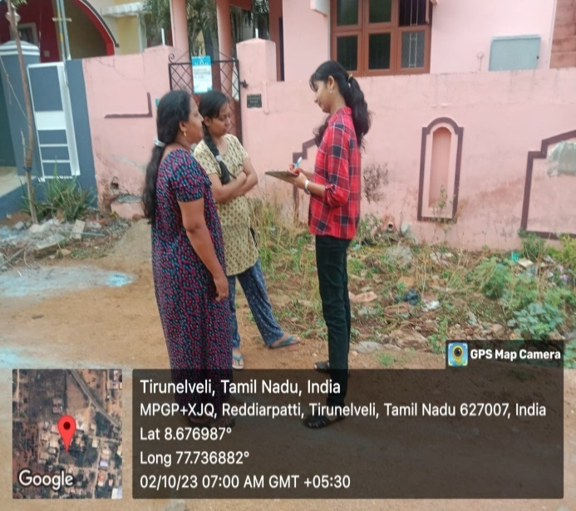
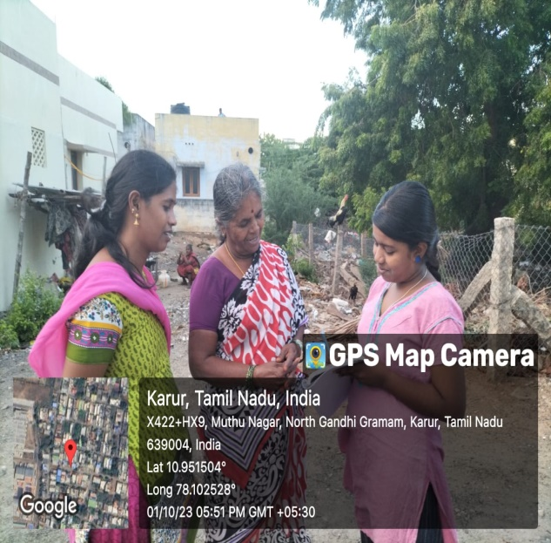
PROBLEM STATEMENT
During the survey we found out that the farmers are cheated that the land is agricultural land while the land is actually used for commercial purpose using our project we simplified and people can easily find whether the land is used for agricultural or commercial purpose by the detection of What are the mineral present in the soil.
We also found that the miners are facing several problems during mining process which leads to cause of disease so we simplified the task using ESP32CAM and which is already in extinction but our project simplified and detect the mineral materials quickly and it is safety for the miners to use.

Slide 5
METHODLOGY
Taking images using the ESP32CAM
Send images to the peripheral devices
Peripheral devices connected with Bluetooth and wifi
Devices recognize the photo with the help of sample material
The amount mineral present in the soil is detected
Shows whether the soil is suitable for Mining minerals site or agricultural site or building construction site

Slide 6
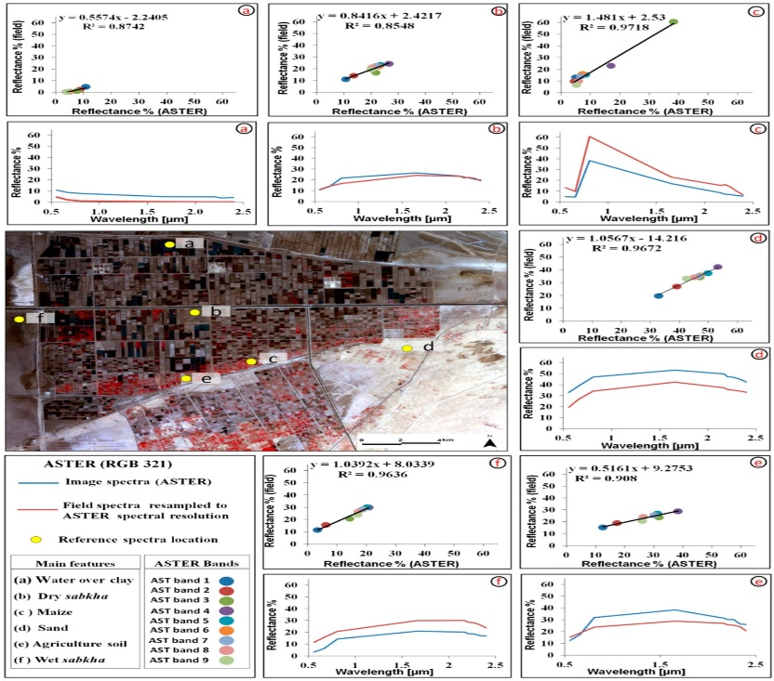
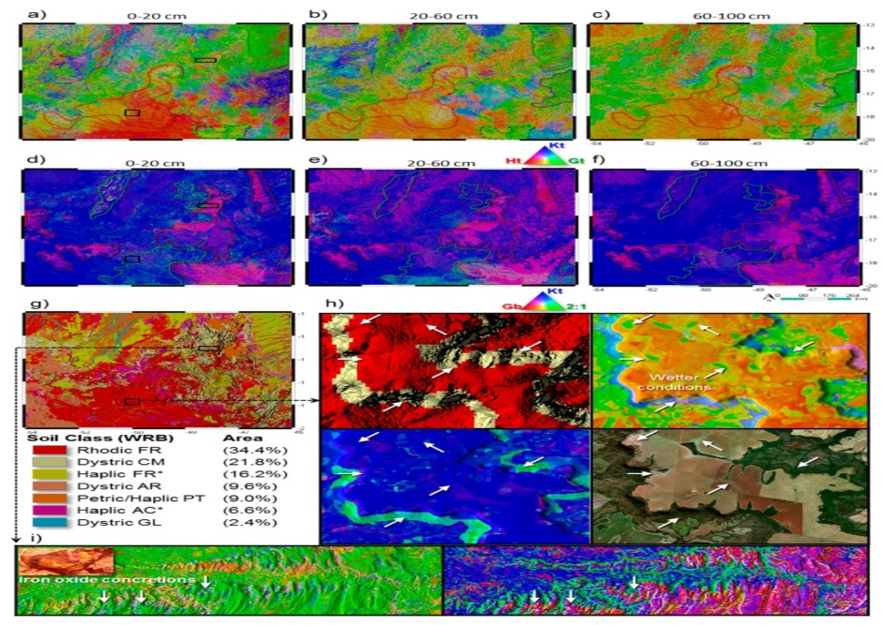
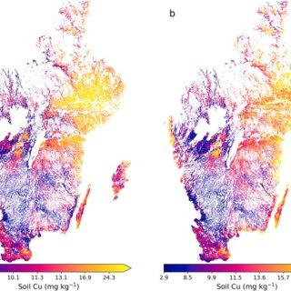
FINAL PREDICTED RESULTS

Slide 7
READINGS FOR AGRICULTURAL SITE
CALCIUM(Ca) (SILVERY WHITE) | POTASSIUM(K)(SILVERY LUSTURE) | SULPHUR(S) (PALE YELLOW) | MAGNESIUM(Mg) (SILVERY GRAY) | NITROGEN(N) (COLOURLESS)
6-8 | 8-10 | 5-6 | 6-7 | 9-10
READINGS FOR CONSTRUCTION SITE
CALCIUM(Ca) (SILVERY WHITE) | POTASSIUM(K) (SILVERY LUSTURE) | SULPHUR(S) (PALE YELLOW) | MAGNESIUM(Mg) (SILVERY GRAY) | NITROGEN(N) (COLOURLESS)
<2 | <5 | <5 | <4 | <6

Slide 8
EXISTING SYSTEM
The existing system for both mining, mineral detection, and assessing soil suitability for agriculture or construction purposes involves deploying ESP32-CAM modules within relevant sites.
These modules utilize their integrated OV2640 cameras and Wi-Fi capabilities to capture images of mining materials and soil samples.
Through wireless connectivity, the ESP32-CAM sends these images to a central server or peripheral devices for analysis.
This integrated system enables real-time monitoring and decision-making, enhancing efficiency and resource management in both industries.

Slide 9
Proposed system
JUPYTER NOTEBOOK (FORMELY IPYTHON NOTEBOOK):
It is a web-based interactive computational environment for
creating notebook documents.
Jupyter Notebook is similar to the notebook interface of other ordered
list of input/output cells which can contain code, text (using
Github Flavored Markdown), mathematics, plots and rich media.
A Jupyter Notebook application is a browser-based REPL containing an
programs such as Maple, Mathematica, and SageMath, a computational
interface style that originated with mathematics.

Slide 10
ANACONDA SOFTWARE:
Anaconda is the Open Source data science distribution for the Python and R programming languages scientific computing, such as data science, machine learning applications, predictive analysis, large-scale data processing, etc.
The Anaconda can be used to simplify package management and deployment.
APPLICATIONS
1)Automated Material Identification: Uses camera and microcontroller to identify materials as they are unearthed.
2)Quality Control and Sorting: Sorts materials based on predefined criteria like quality or type.
3)Safety Monitoring: Detects unsafe conditions and triggers alarms or shutdowns.
4)Remote Monitoring and Control: Allows remote access for monitoring and intervention.

Slide 11
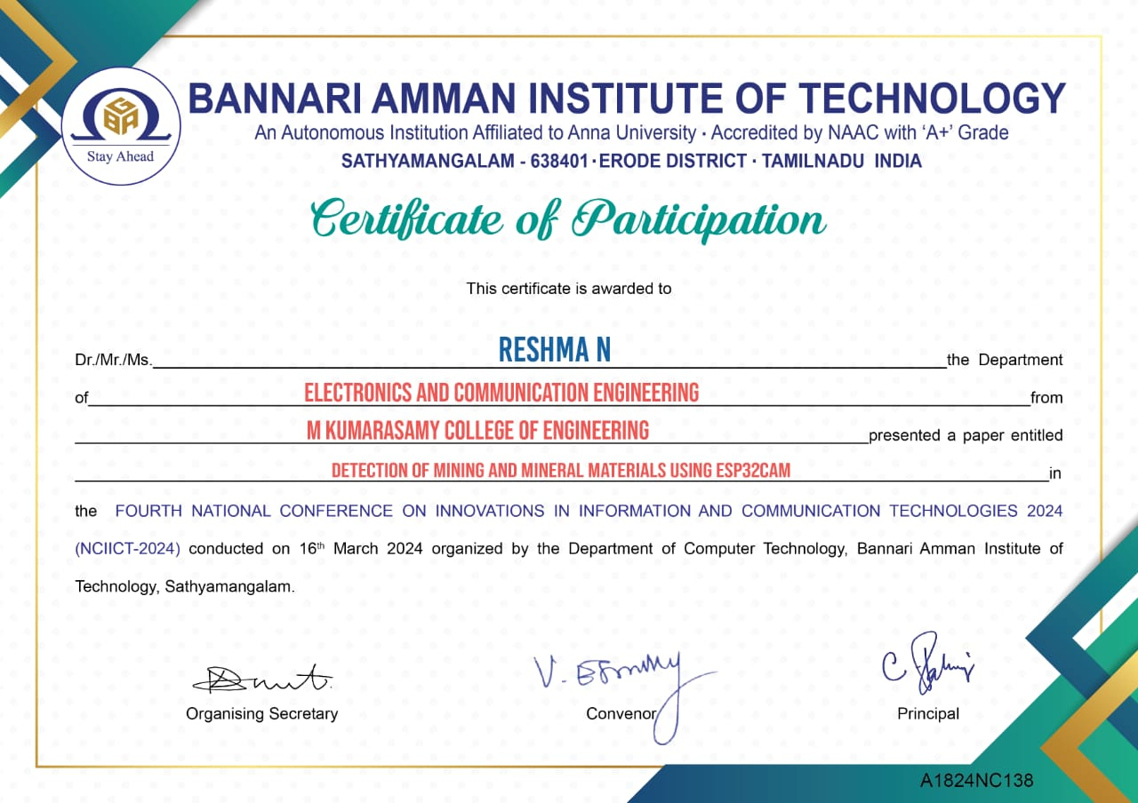
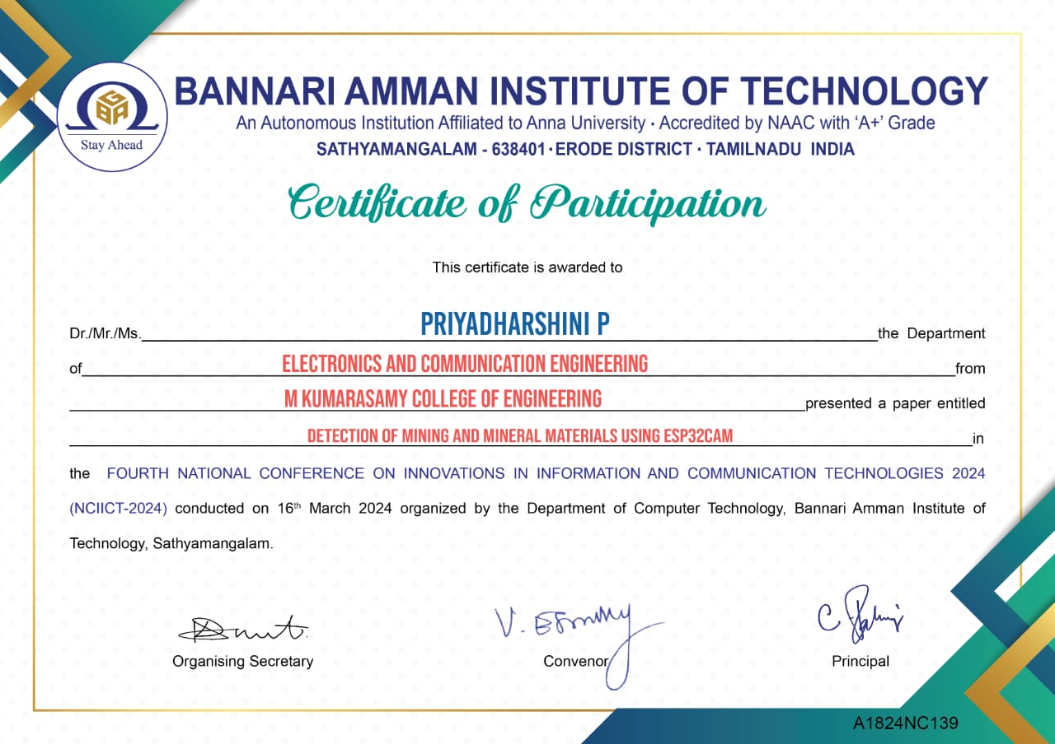


outcome of our project

Slide 12
Conclusion
Thus by using this proposed system we can easily identify the minerals present in the soil.
So these are the expected impacts of the proposed system (e.g., enhanced soil recovery post-mining, better agricultural outcomes).

Slide 13
REFERENCES
1. Basov A.D., Romanevich K.V., Shlyaev S.A. 2015.Monitoring system of continuous recording of natural electromagnetic radiation in operating transport tunnels .Materials of the international scientific and practical conference and exhibition EAGO “Engineering, coal and ore geophysics .Current state and development prospects”, 76–80.
2. Bezrodny K.P., Basov A.D., Romanevich K.V.2011. Control of the stress-strain state of the rock mass during tunnel construction using natural electromagnetic radiation method .Izvestiya of Tula State University .Earth sciences, Issue 1, 227–234.
3. Dolgiy M.E., Kataev S.G. 2015. Studying the natural pulsed electromagnetic field of the Earth. Bulletin of Tomsk State University, No. 2 (34), 61–66.
4. Gurieva A.A. 2017.Sustainable development of oreraw materials and enhanced capacities of apatitjsc based on best engineering solutions. Mining University collection of scientific papers, V 228, 662 -673.
5. Hayakawa M., Molchanov O.A., Nickolaenko A.P.2002. Model variations in atmospheric radio noise caused by pre-seismic modification of tropospheric conductivity profile.seismo electromagnetics. Lithosphere Atmosphere-Ionosphere Coupling, 349–352.

Slide 14
6. Kharkevich, A.S. 2006. Forecasting of the position of zones of geodynamic activity of coal seams by geophysical methods in the mines of Kuzbass. Сollection of scientific papers of All-Russian Research Institute of Mining Geomechanics and Survey, 290–299.
7. Kuranov A.D. 2012. Determination of the parameters of the spatial strength condition of the mounting sites of ore careers in high- spinded scalar massives. Mining University collection of scientific papers.V 199, 111 -117.
8. Kuranov A.D., Zuev B.Y., Istomin R.S. 2018. The forecast deformations of the ground surface during mining under protected objects. Innovation-Based Development of the Mineral Resources Sector:Challenges and Prospects – 11th conference of the Russian-German Raw Materials, 39–50.
9. Malyshkov Y.P., Malyshkov S.Y., Gordeev V.F.,Shtalin S.G., Polivach V.I., Krutikov V.A., Zaderigolova M.M. 2015. Horizons in World Physics, Volume 283. Nova Science Publishers Inc., New York
.
10. Popov A.L., Parchimchik M.V., Senchina N.P.,Idiyatullin M.M. 2017. Localization of potentially dangerous zones of rock massif by the results of studying natural electromagnetic radiation. VIII International Scientific and Practical Conference “Innovative approaches in mining enterprises design: geomechanical design support of mining operations”, 238–240.

Slide 15


